Slide 1
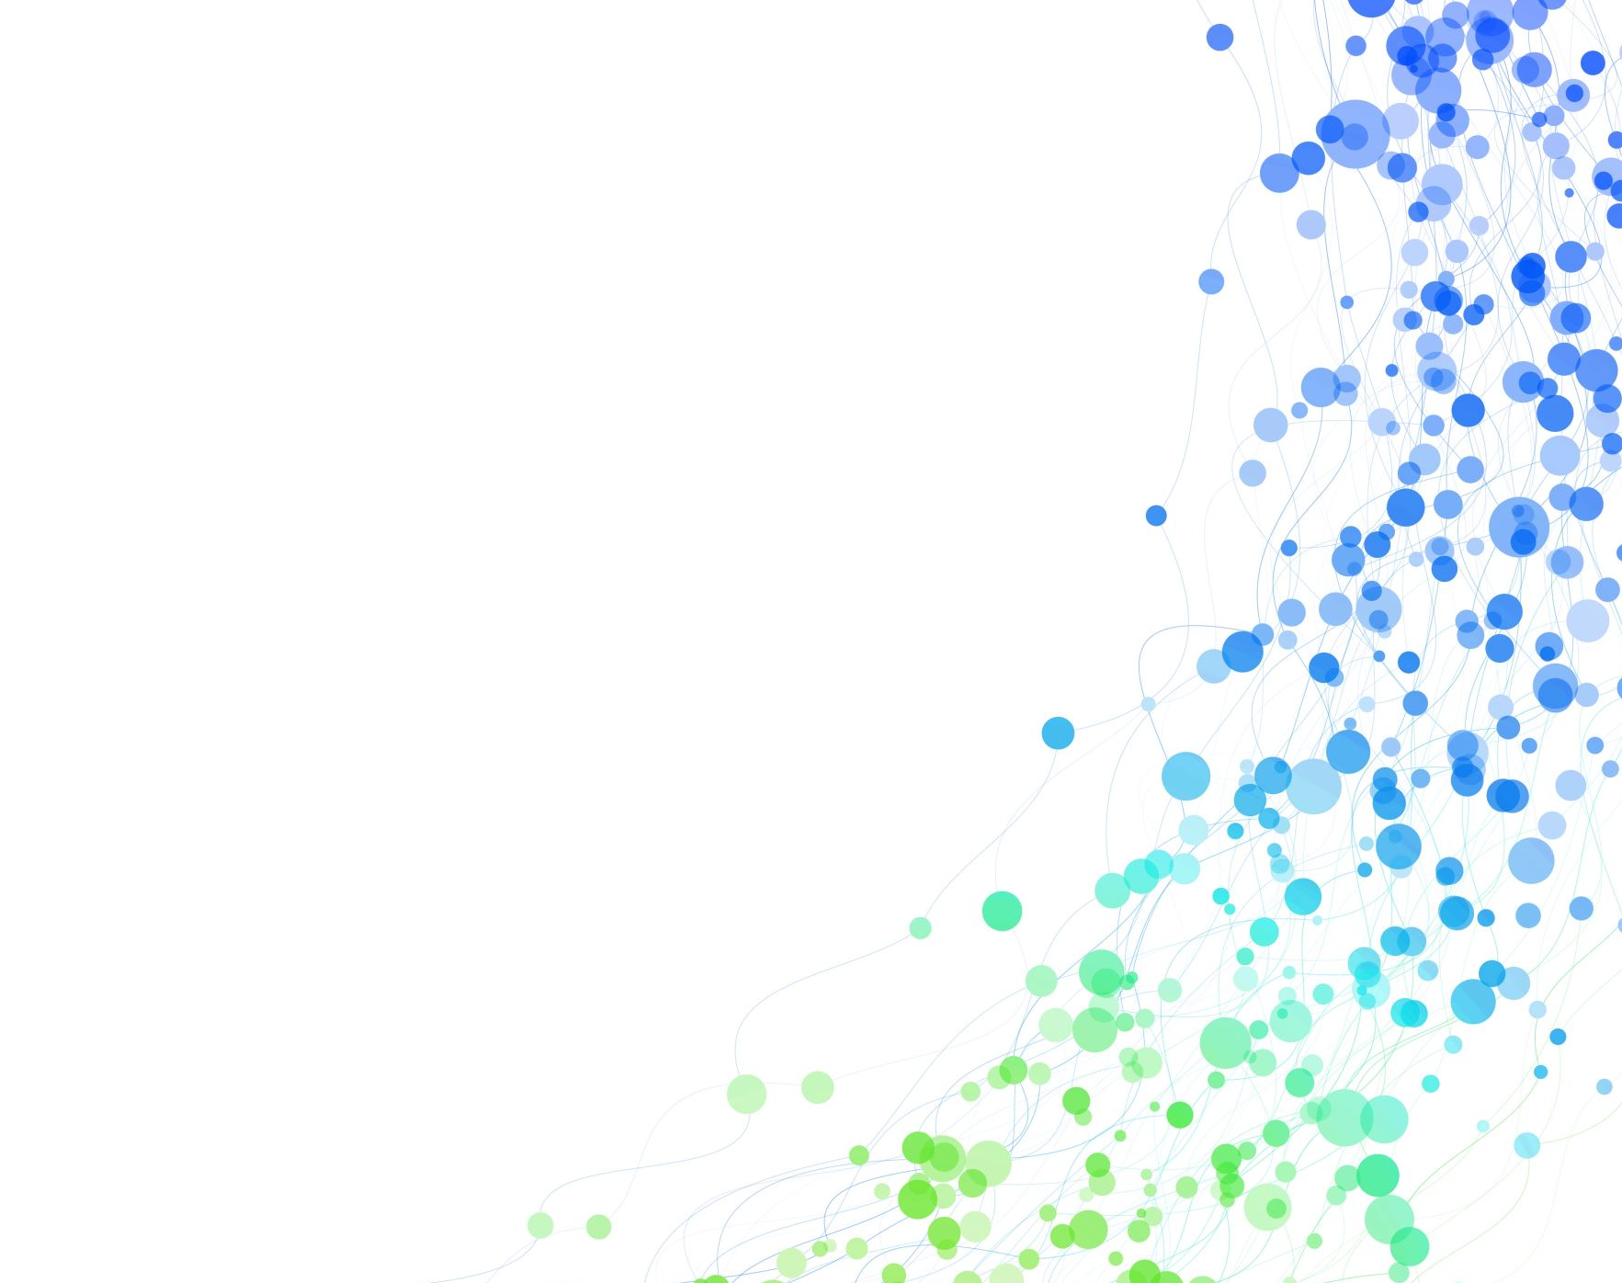
Timing of Respiratory Epidemics Driving Seasonal Influenza-like Illness in the United States
George Dewey

Slide 2
Influenza-like Illness (ILI)
Seasonal influenza-like illness (ILI) affected between 9 and 41 million individuals in the United States between 2010 and 2023
About 8% of the US population develops symptomatic ILI every year

Slide 3
Influenza-like Illness (ILI)
Substantial developments have been made in surveillance and prediction systems for ILI
However, misconceptions about ILI exist in the field:
ILI is driven only by influenza (influenza-like illness)
Surges in ILI activity are caused by outbreaks of influenza A followed by outbreaks of influenza B
We know that ILI is associated with other pathogens
Respiratory syncytial virus (RSV)
Coronaviruses (SARS-CoV-2 included)
Many others (human pneumovirus, parainfluenza virus, etc.)

Slide 4
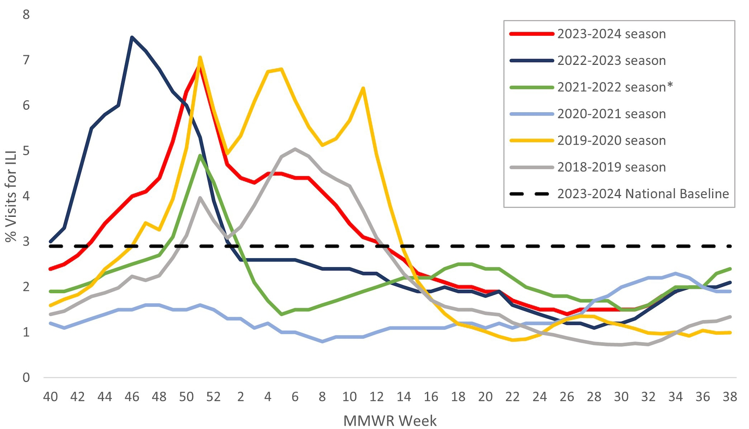
National ILI activity, 2018-2019 to 2023-2024
Multiple peaks
Notes:
https://www.cdc.gov/flu/whats-new/flu-summary-2023-2024.html

Slide 5
Rationale
Anticipating the trajectory (start and peak) of the ILI season is advantageous for public health officials, medical providers, and the public
Improves resource allocation and health communication
Especially important for delivery of therapeutics to at-risk groups
RSV prophylaxis in infants must be delivered before the first RSV season
When to start influenza/RSV vaccinations?

Slide 6
Research Questions
What is the temporal relationship between epidemics of RSV and epidemics of influenza?
Does COVID-19 demonstrate seasonality like RSV and influenza?
Can we quantify the time differences between the onsets and peaks of epidemics using statistical techniques?

Slide 7
Data
Predictors: timeseries data from the last 150 state-ILI seasons from CDC’s National Syndromic Surveillance Program (NSSP)
Outcome: state-level timeseries from CDC ILINet (the percentage of outpatient visits for respiratory illness)
NSSP started collecting emergency department volume associated with influenza, COVID-19, and RSV in October 2022
Data includes the 2022-23, 2023-24, and 2024-25 ILI seasons (ongoing)
Notes:
Missouri did not supply data to NSSP. Data from Vermont was no longer submitted to NSSP as of December 2024.

Slide 8
Methods
Ridge regression to predict ILINet values from timeseries of influenza, RSV, and COVID-19
Lagged correlation analyses to determine lag between epidemics

Slide 9
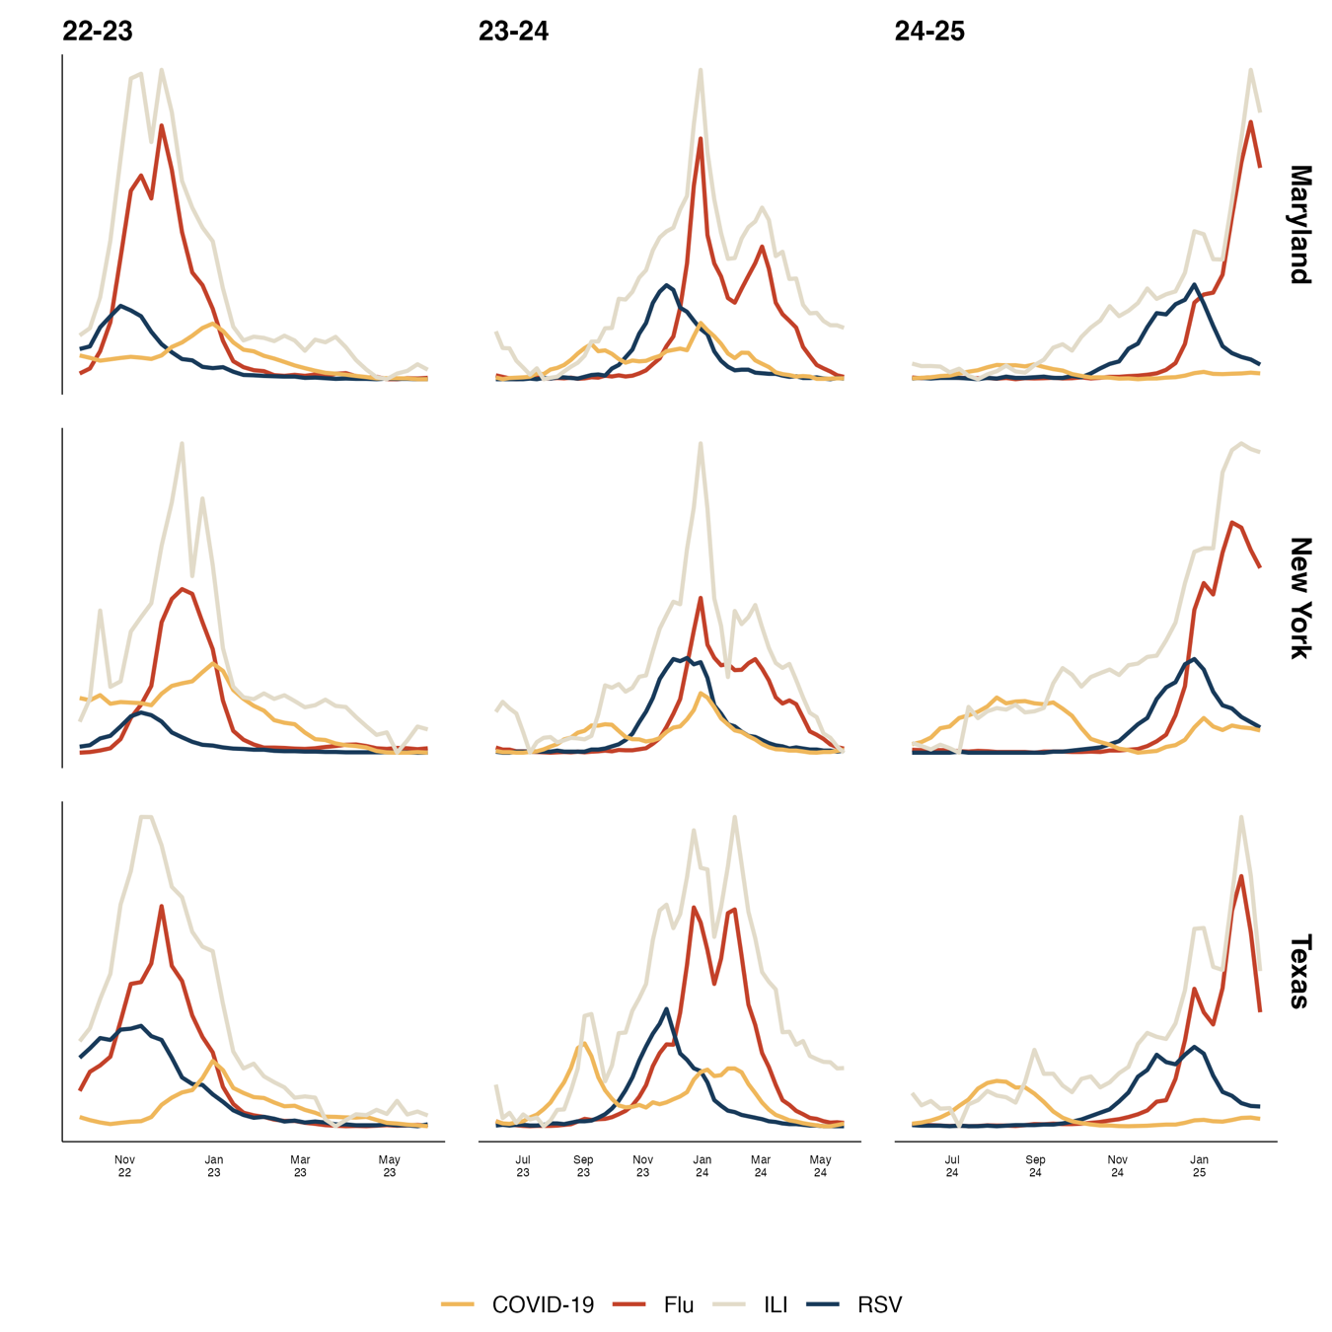
Results
Peak of RSV
Peak of flu
In general, the ILI season starts in late Oct/early Nov and ends by March
In 128/150 (84%) of analyzed state-ILI seasons, RSV epidemics reached their peak before epidemics of influenza
Concurrent peaks of RSV and influenza (15/150 seasons, 10%) and seasons where influenza epidemics peaked before RSV epidemics (19/150 seasons, 12.7%)

Slide 10
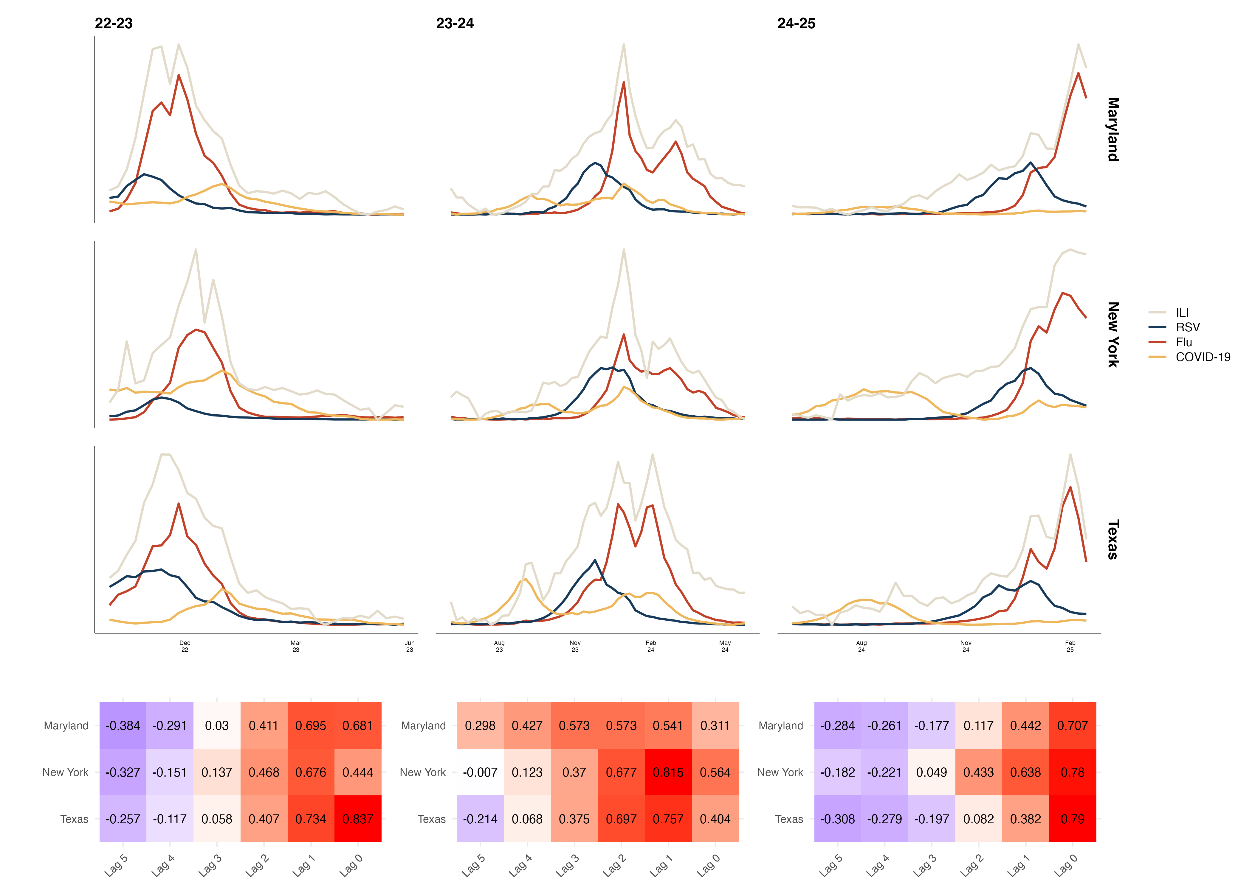
Notes:
Current version of Fig. 1

Slide 11
Individual State Figures

Slide 12
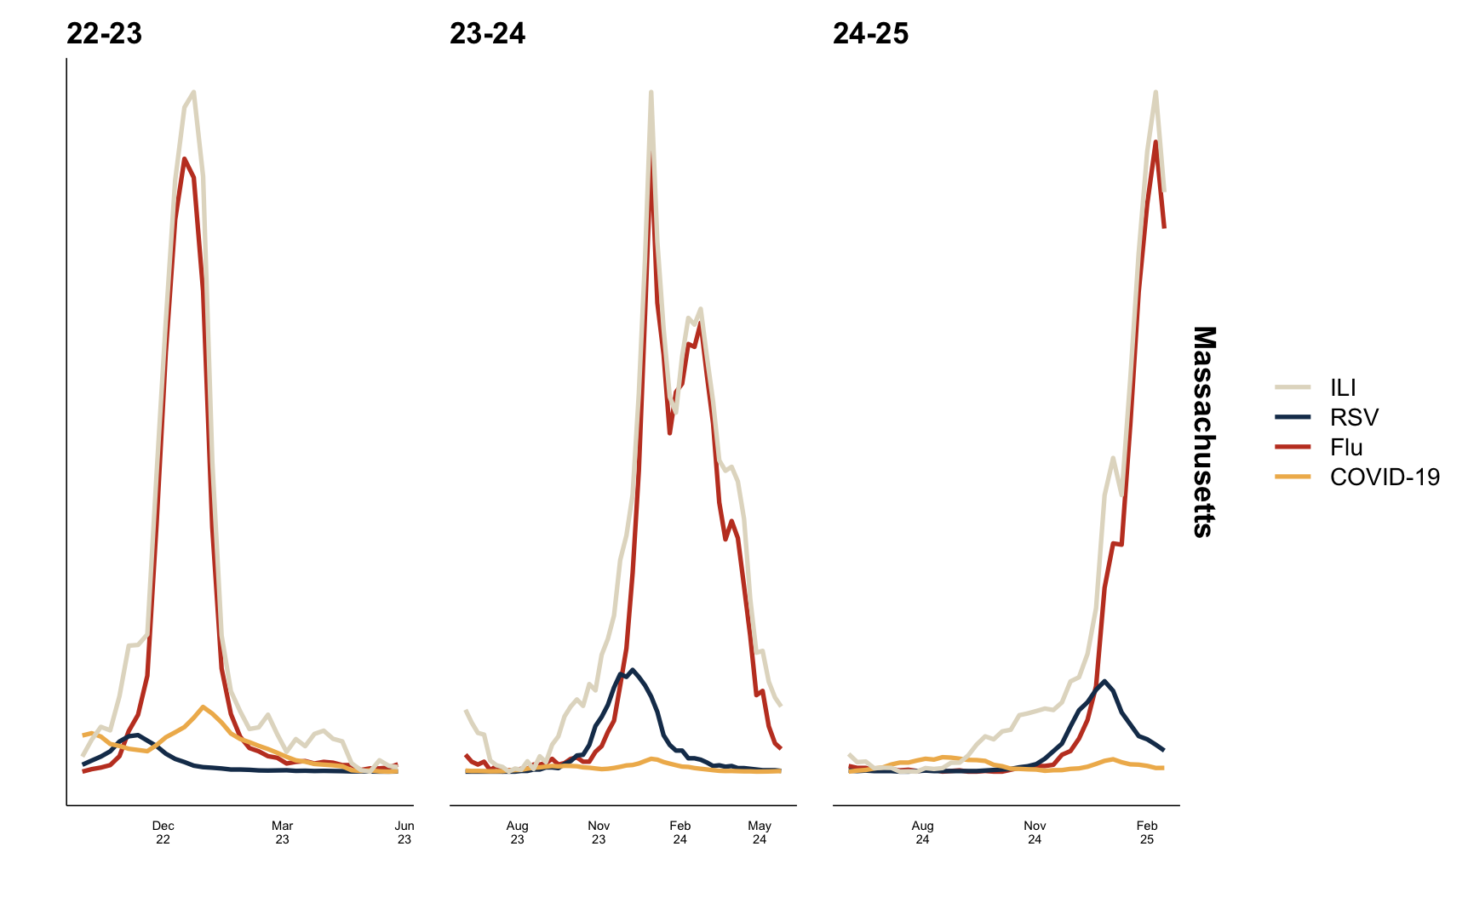

Slide 13
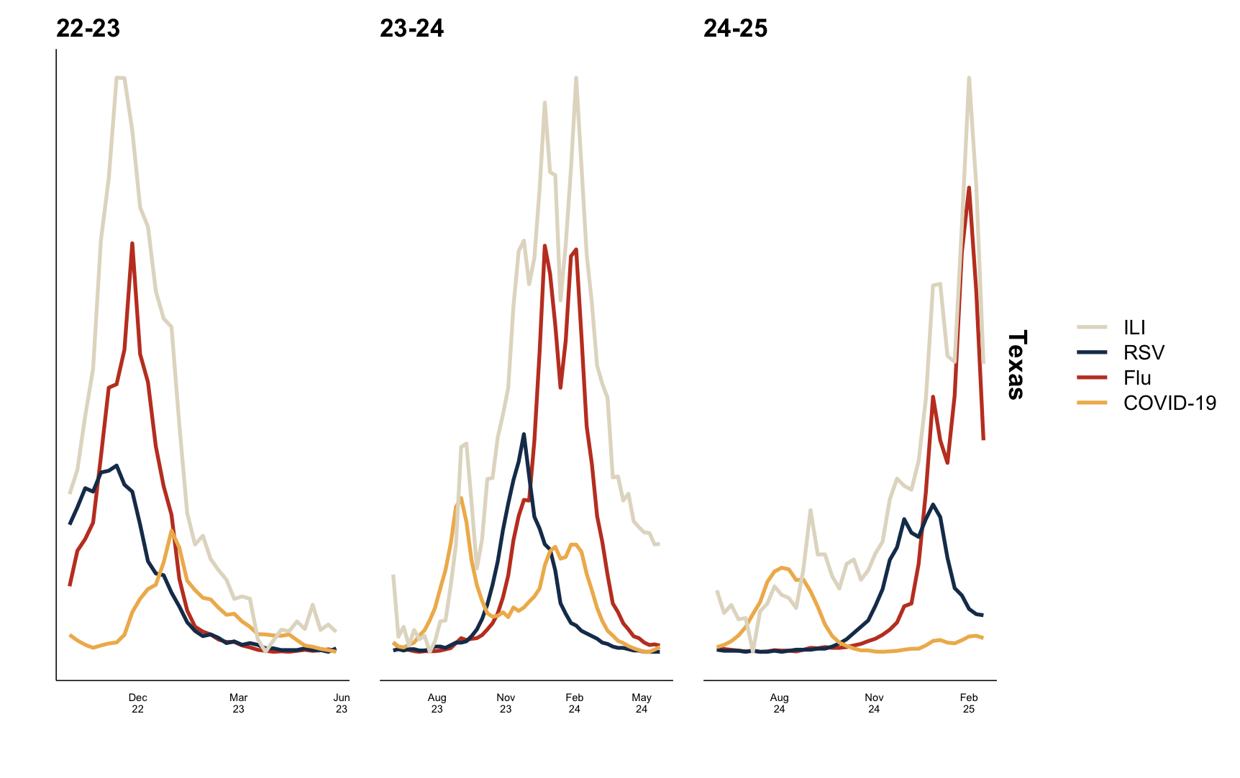

Slide 14
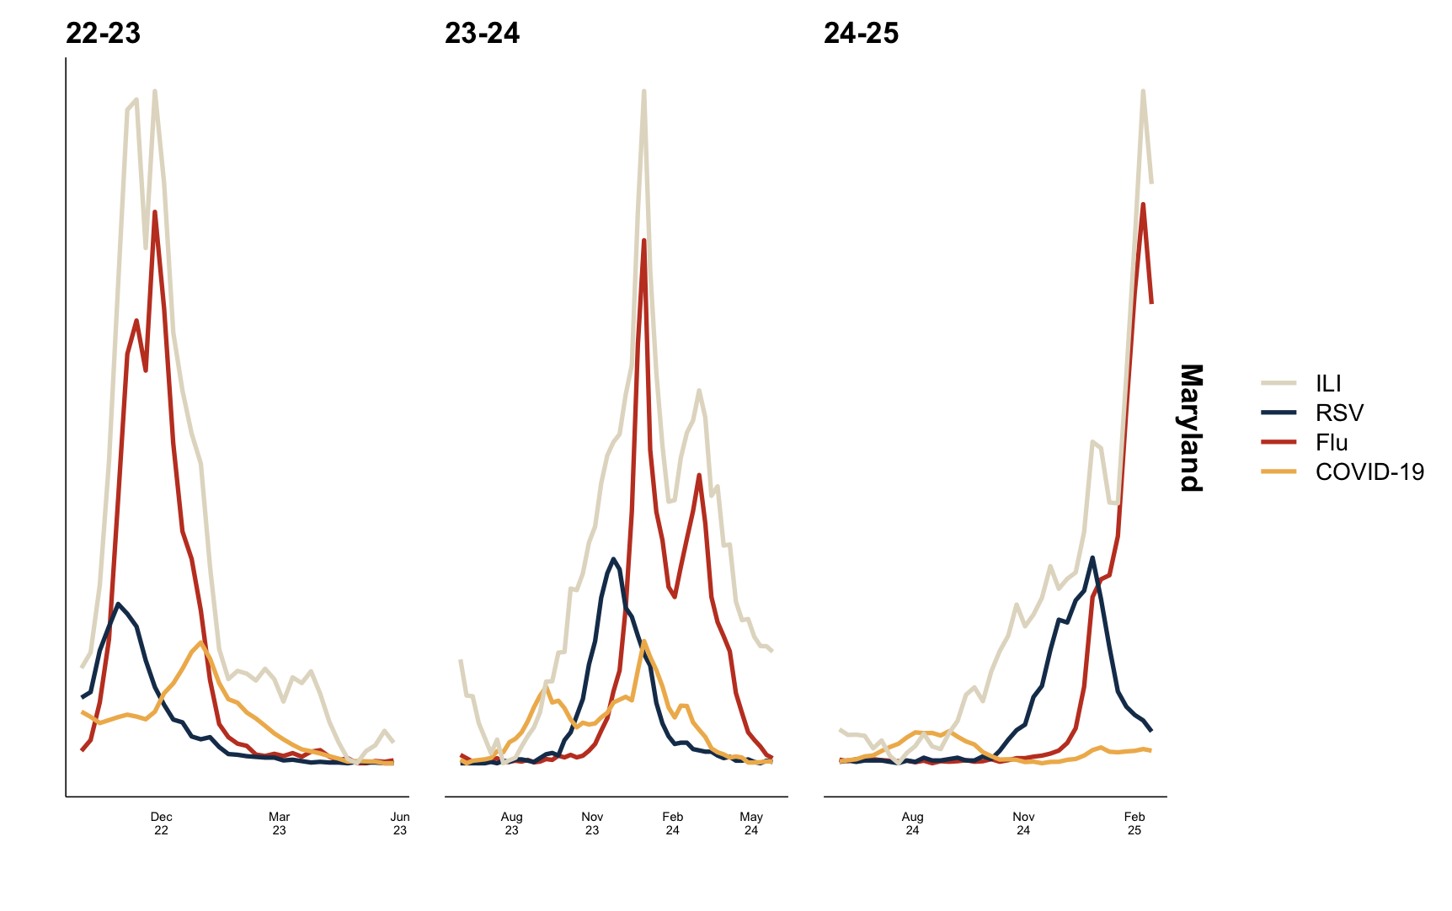

Slide 15
Correlation Heatmaps

Slide 16
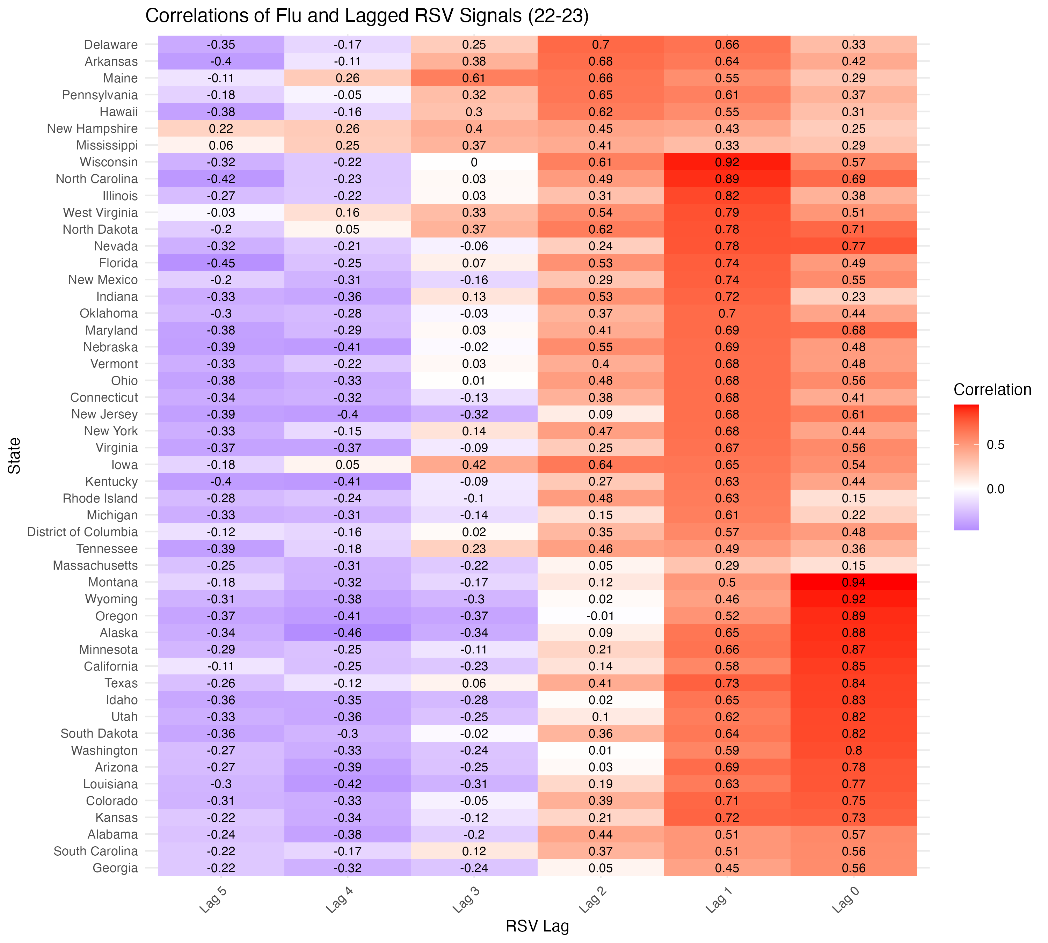

Slide 17
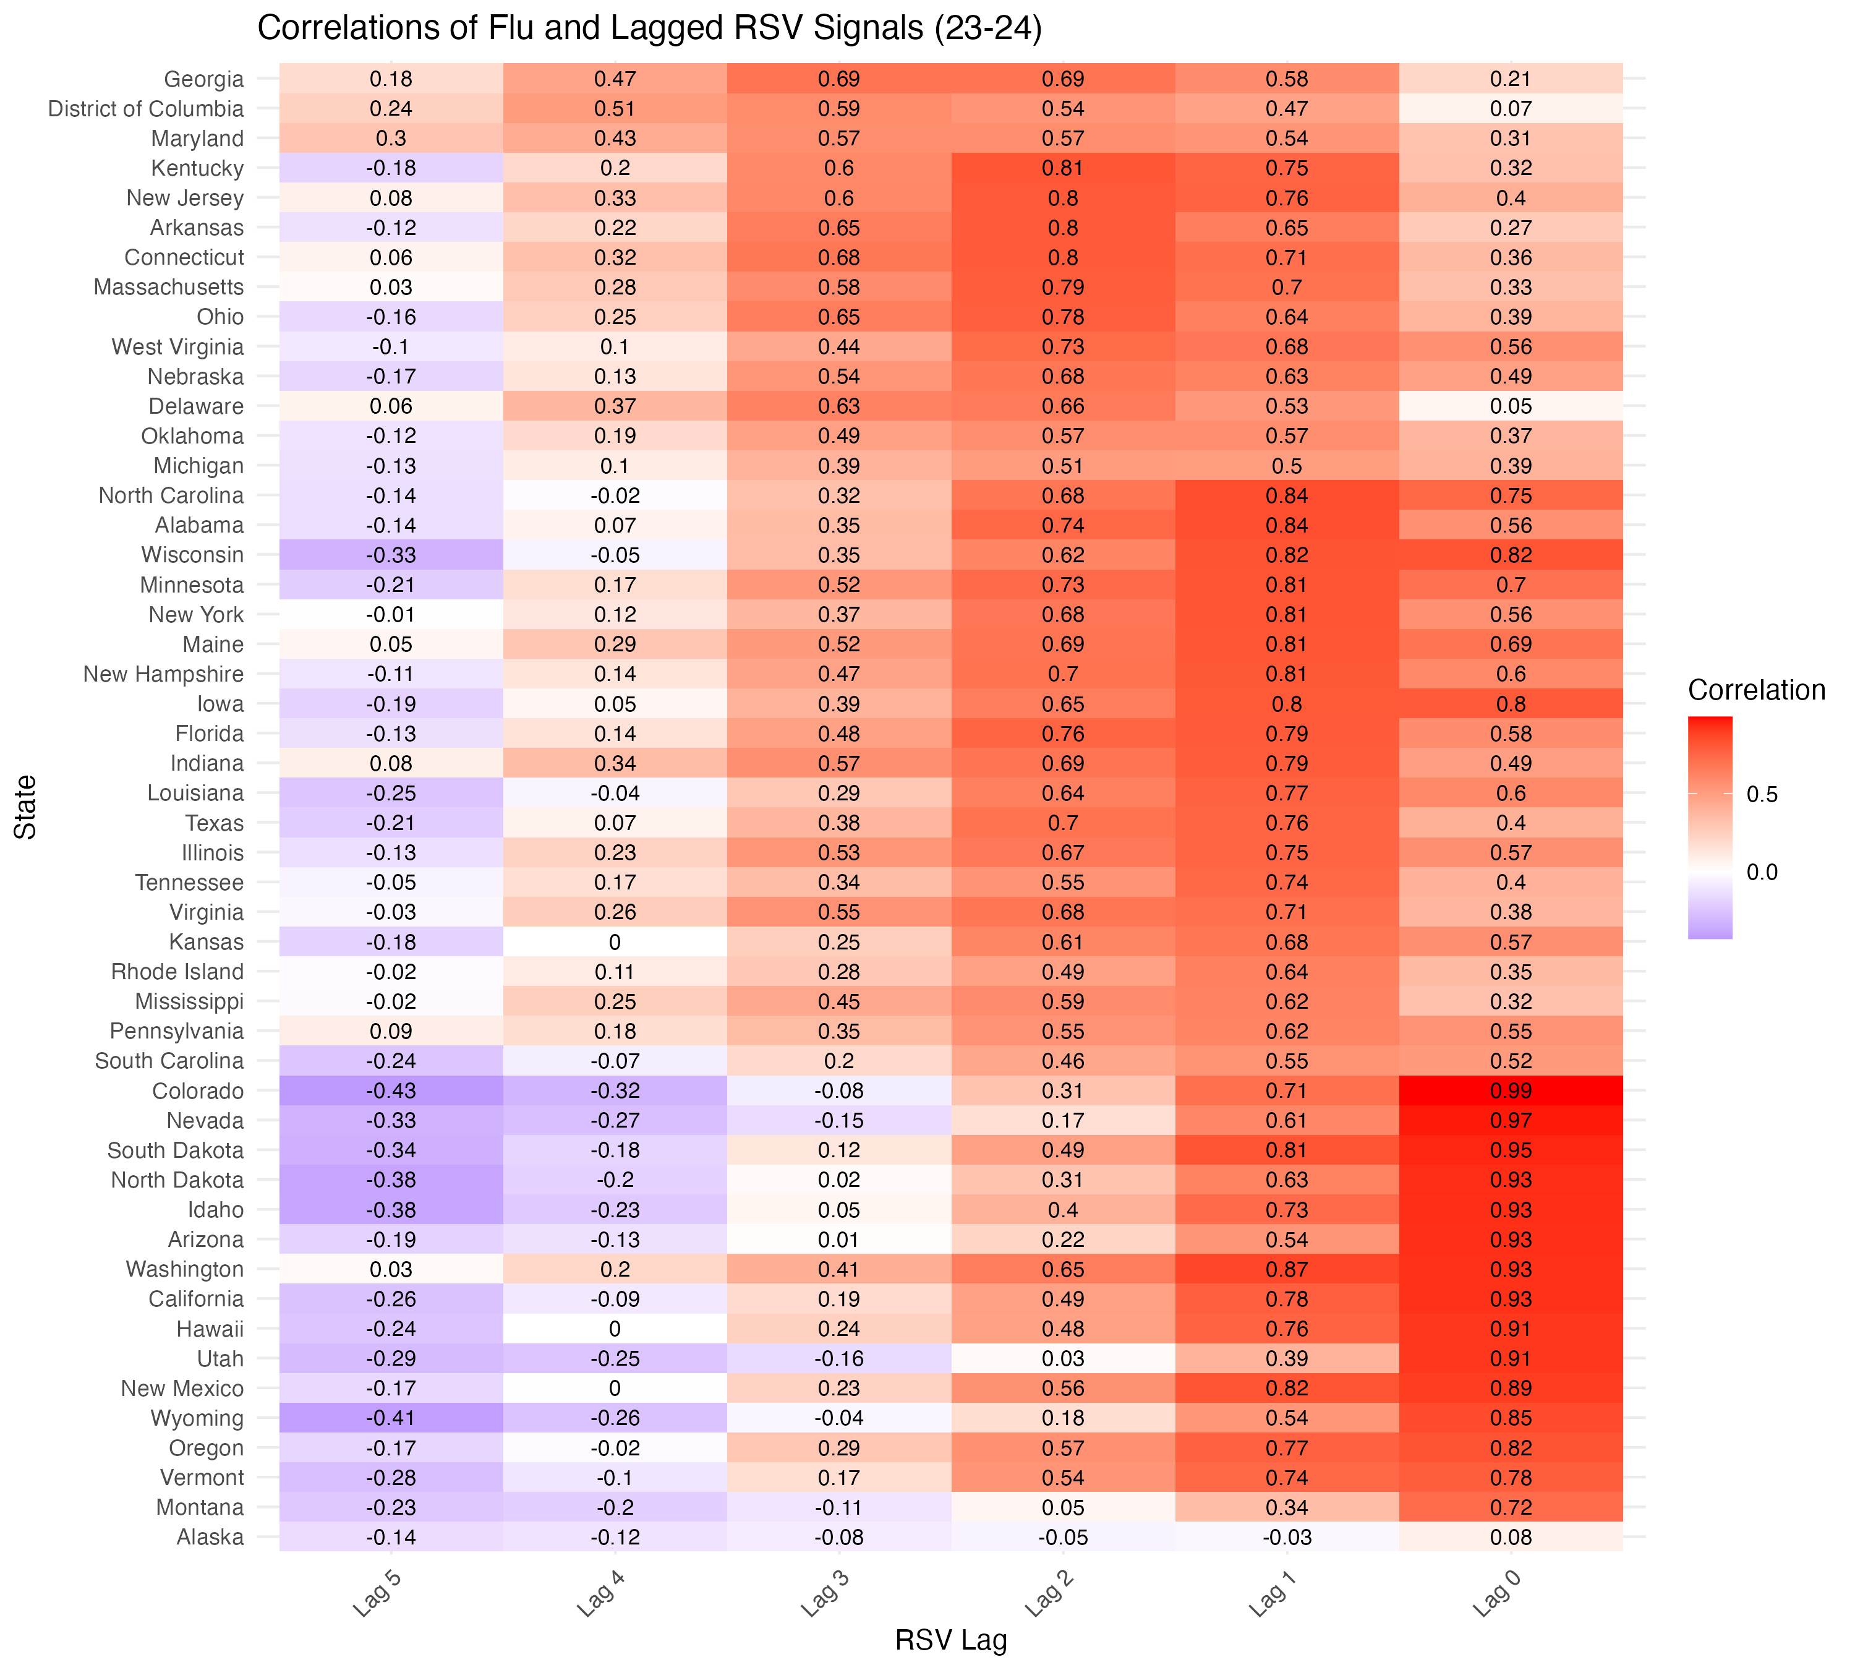

Slide 18
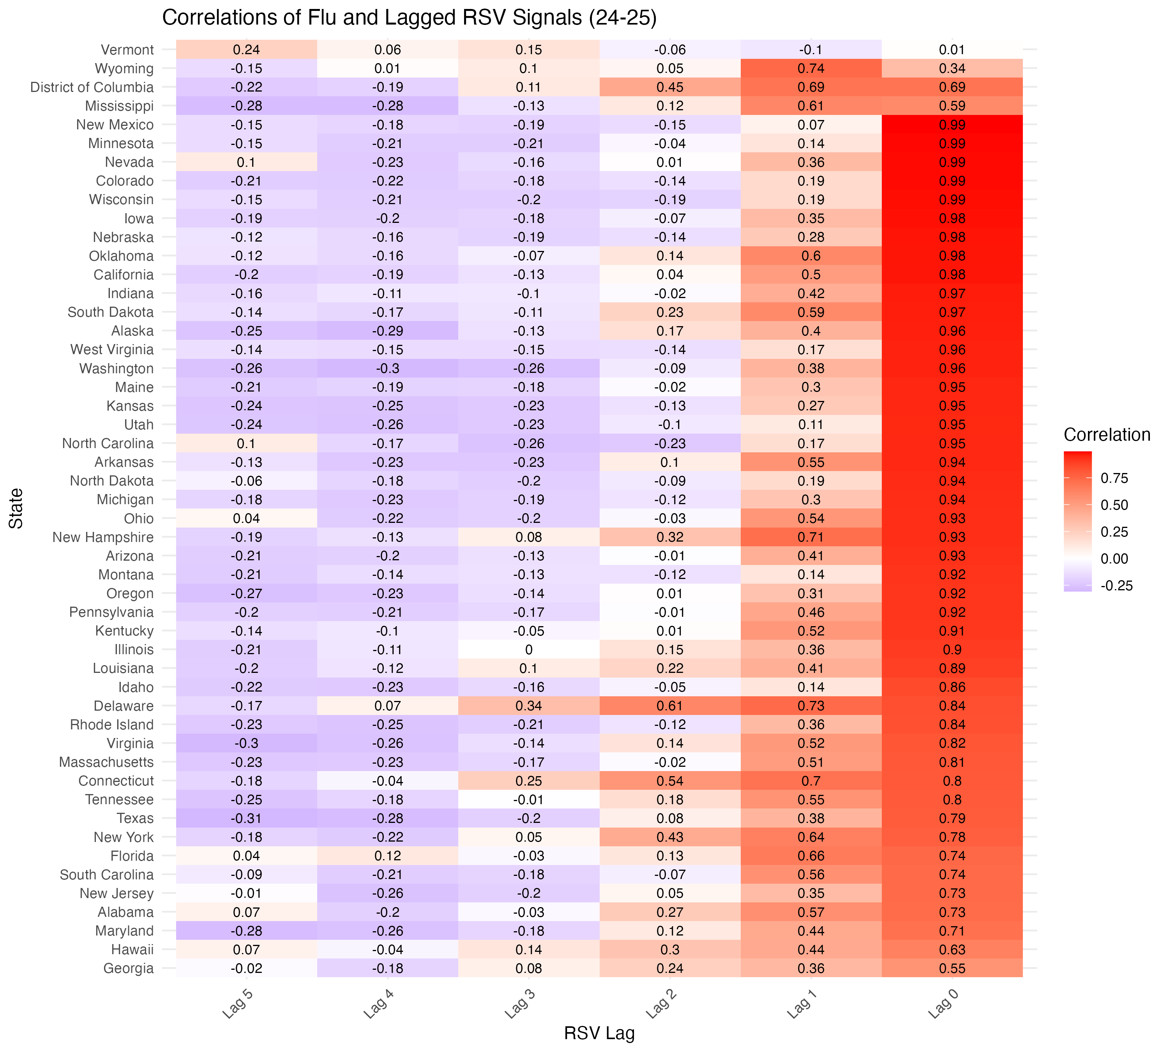

Slide 19
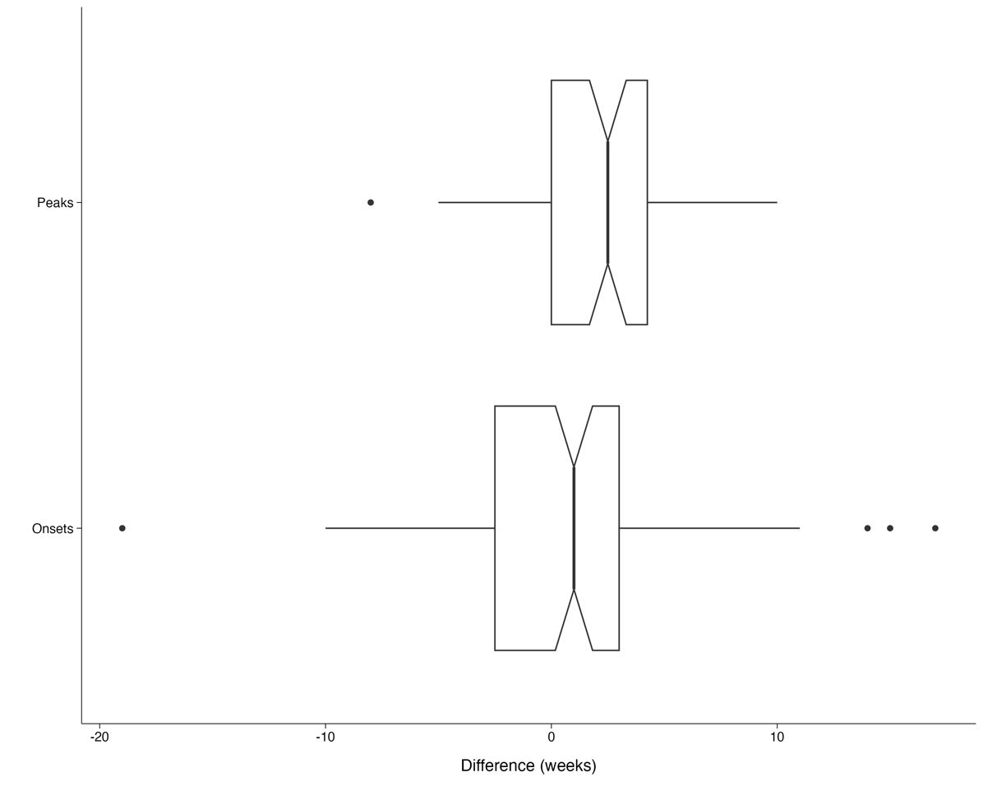
Results from Early Warning System
Median of 2.5 weeks between peaks of RSV and peaks of influenza
Median of 1 week between onsets of RSV and onsets of influenza*

Slide 20
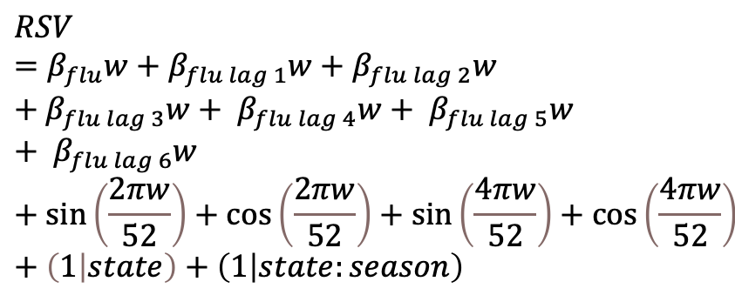
Results from Lagged Mixed-Effects Model
Fixed Effects
 | Beta | Standard Error | P-value
Intercept | 0.2464 | 0.0148 | < 0.0001
Flu | 0.0729 | 0.0027 | < 0.0001
Flu (lag 1) | -0.0202 | 0.0027 | < 0.0001
Flu (lag 2) | -0.0062 | 0.0027 | 0.0237
Flu (lag 3) | -0.0026 | 0.0027 | 0.3401
Flu (lag 4) | -0.0026 | 0.0027 | 0.3410
Flu (lag 5) | -0.0008 | 0.0027 | 0.7549
Flu (lag 6) | -0.0102 | 0.0024 | < 0.0001
Supplementary Table 1: Lagged random intercepts model results assessing the association between lagged flu values and RSV. Random intercepts were included to account for both state-level variance and seasonal variance within states. The model accounts for seasonality by including semi-annual and annual seasonality terms.
$$RSV=β_{flu}w+β_{flu lag 1}w+β_{flu lag 2}w+β_{flu lag 3}w+ β_{flu lag 4}w+ β_{flu lag 5}w+ β_{flu lag 6}w+\sin\left(\frac{2πw}{52}\right)+\cos\left(\frac{2πw}{52}\right)+\sin\left(\frac{4πw}{52}\right)+\cos\left(\frac{4πw}{52}\right)+\left(1 | state\right)+\left(1 | state:season\right)$$
Flu values from 1 week prior and 2 weeks prior are associated with RSV
Flu values from 3-5 weeks are small and non-significant

Slide 21
Discussion
RSV epidemics frequently precede epidemics of influenza
Correlation analysis suggests a lag of 1-3 weeks between outbreaks of RSV and influenza
Next steps: incorporate last month of 24-25 ILI season data, validation of results using early warning system
Public health officials and medical providers should reasonably expect surges in RSV cases in early fall to represent the start of the ILI season

Slide 22
Next Steps
Wait for more data
Currently in the 24-25 ILI season – ongoing flu outbreaks!
Refinement of the regression algorithm
Even after using 10-fold cross validation, the lambda parameter for ridge regression is not optimized
Due to multicollinearity, one signal can be dropped
Adaptive or MSE-based lambda selection
Update visuals
Next: show distribution of time differences using violin plot

Slide 23
Timeseries Plots (all States)

Slide 24
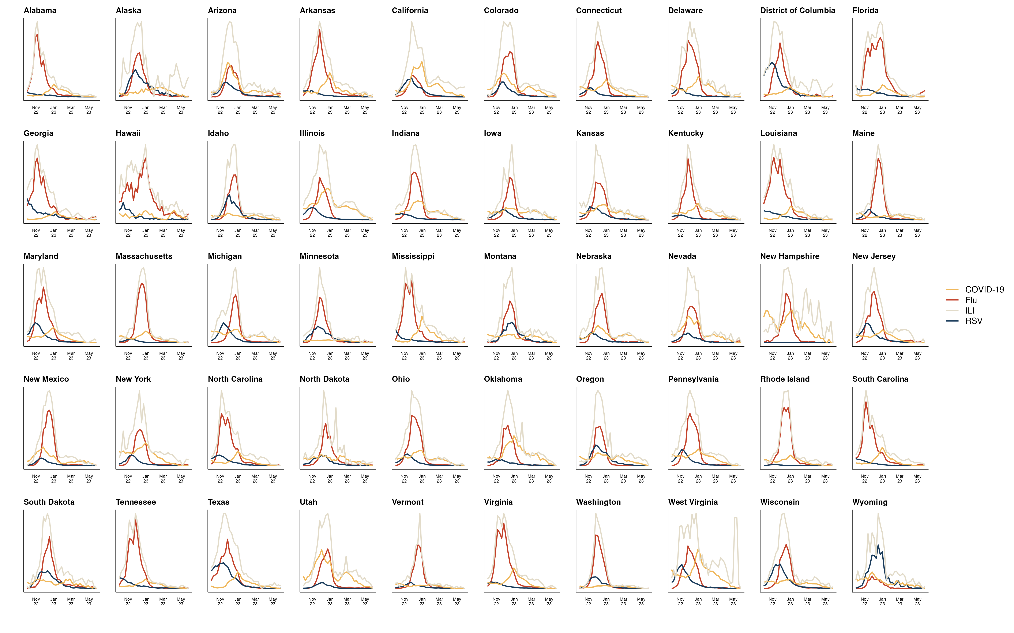

Slide 25
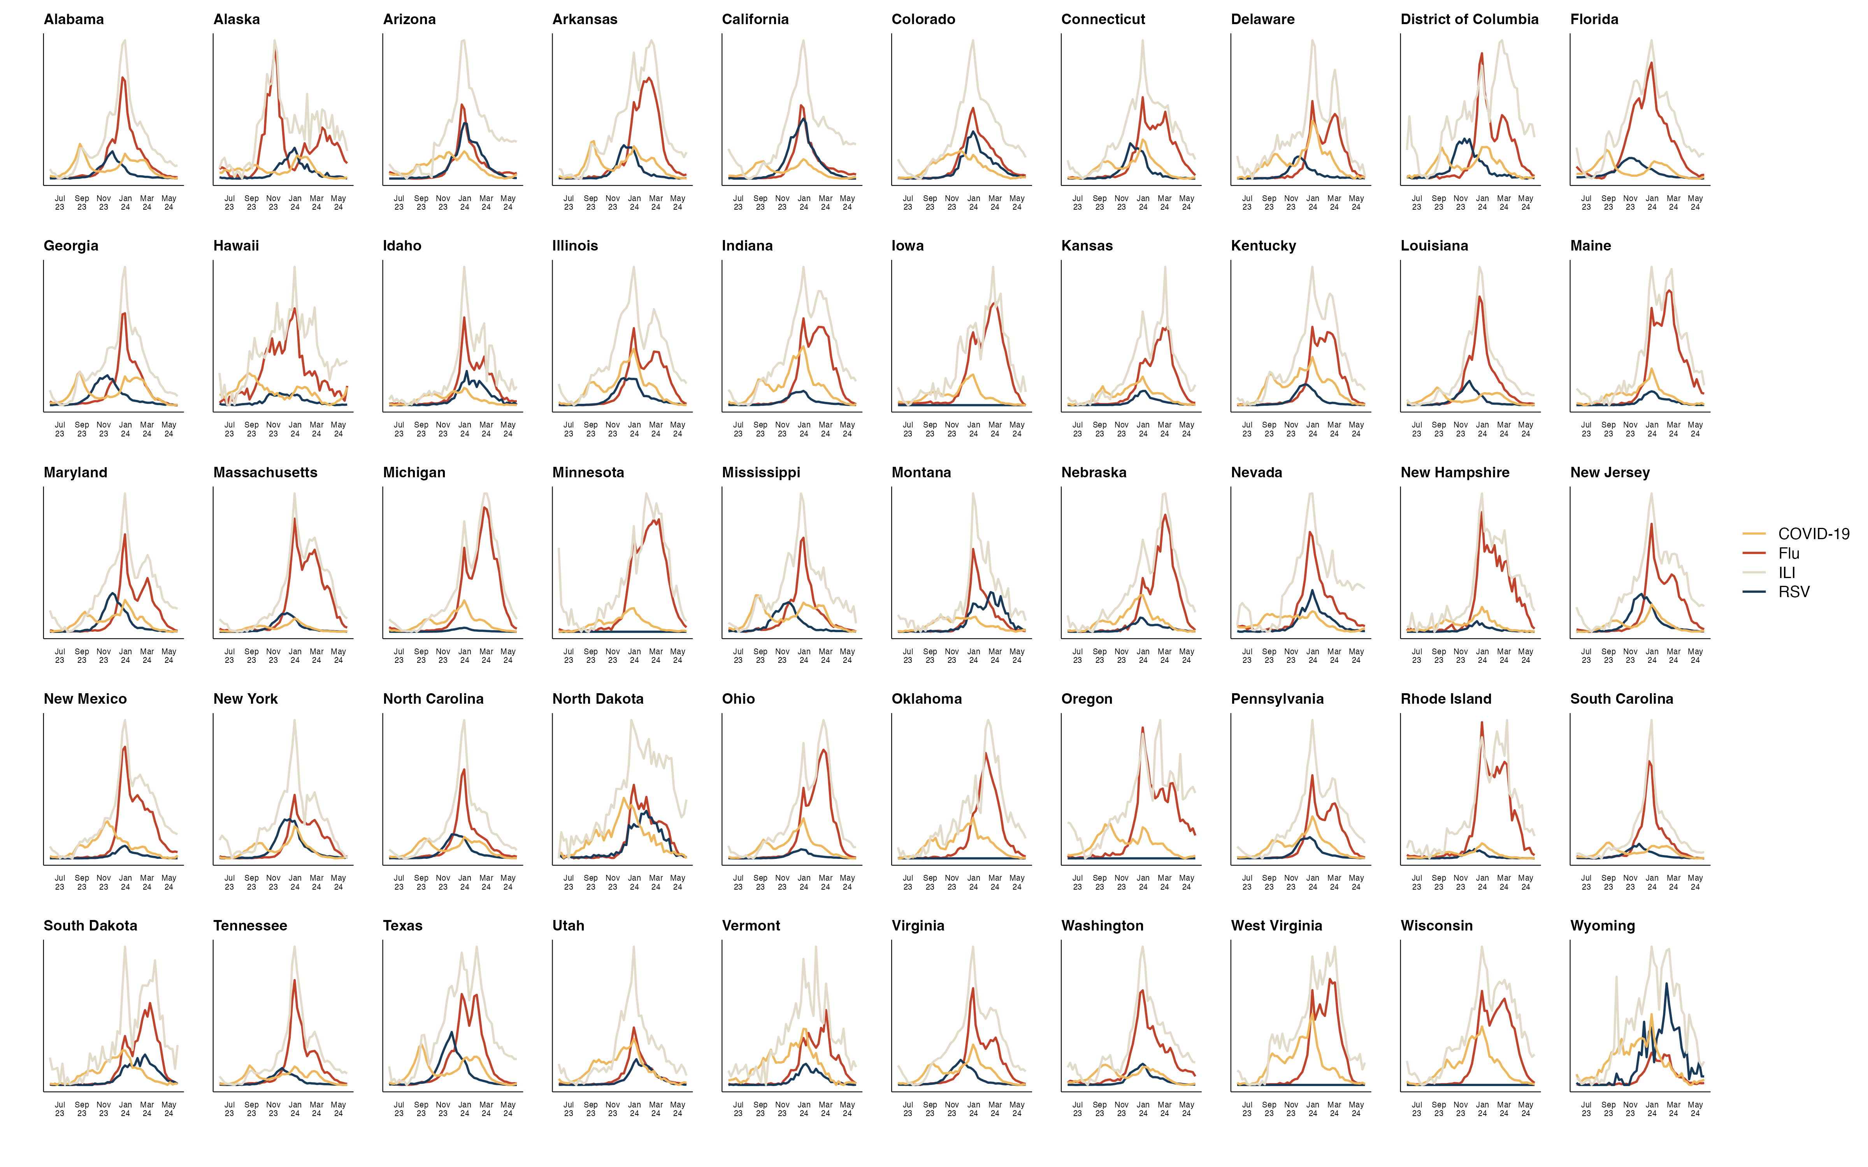

Slide 26
